Slide 1


Introduction to data tables and data frames using Python (Pandas)

Slide 2
Learning Objectives
By the end of this session, you will be able to:
Understand Data Tables and DataFrames in Python.
Learn how to create, manipulate, and analyze data using pandas and NumPy.
Explore key operations like indexing, filtering, aggregation, and merging.

Slide 3
Different Data Types: Quick Reference
Data Types | Definition
List | An ordered, mutable collection of elements that allows duplicates. Defined using [ ].
Tuple | An ordered, immutable collection of elements. Defined using ( ).
Dictionary | A key-value pair collection that is unordered and mutable. Defined using { }.
Array (NumPy) | A fixed-type collection of elements optimized for numerical computations. Requires NumPy.
Series (Pandas) | A one-dimensional labeled array where each element has an index. Used in Pandas for data analysis.
DataFrame (Pandas) | A two-dimensional table-like data structure with labeled rows and columns. Used for structured data manipulation.

Slide 4
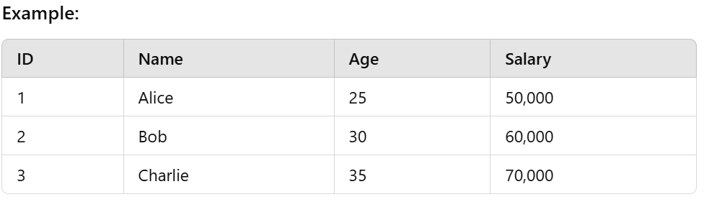
What is a Data Table?
A Data Table is a structured way to store and organize data in a tabular format with rows and columns.
It allows for easy access, manipulation, and analysis of data.
Commonly used in databases (SQL), spreadsheets (Excel), and programming languages (Python Pandas, R, etc.).
Used in Python through Pandas DataFrames.

Slide 5
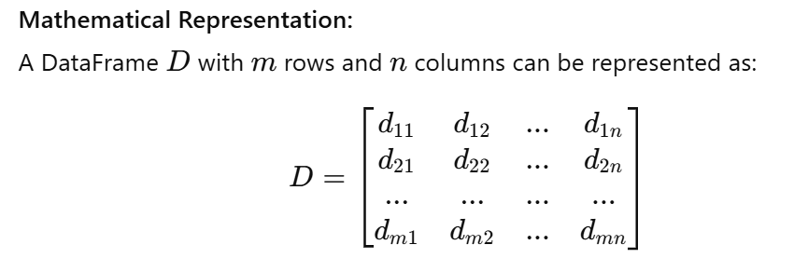
What is a DataFrame?
A two-dimensional labeled data structure in Pandas.
Columns can have different data types (e.g., int, float, string).
It’s similar to a SQL table or a spreadsheet in Excel.

Slide 6
DataFrames in Python
Creating DataFrames in Python
Data Operations on DataFrames
Modifying Data in DataFrames
Aggregations and Summary Statistics

Slide 7
Multiple Choice Questions (MCQs)
Q1: What is the primary difference between a Python list and a Pandas DataFrame?
A. Lists store only numbers, DataFrames store only text.
B. Lists are 1D, DataFrames are 2D.
C. Lists are used only in machine learning.
D. DataFrames cannot store numerical data.

Slide 8
Multiple Choice Questions (MCQs)
Q1: What is the primary difference between a Python list and a Pandas DataFrame?
A. Lists store only numbers, DataFrames store only text.
B. Lists are 1D, DataFrames are 2D.
C. Lists are used only in machine learning.
D. DataFrames cannot store numerical data.

Slide 9
Fill in the Blanks
A DataFrame is a ______ data structure used for data manipulation in Python.
In a Data Table, the horizontal sections are called ______, and the vertical sections are called ______.
A dictionary in Python stores data as ______ pairs.
A tuple is similar to a list, but it is ______, meaning its values cannot be changed.
The process of summarizing and organizing data to extract useful insights is called ______.
The vertical sections in a DataFrame, each representing a specific attribute or feature, are called ______.
A structured collection of data that is stored electronically and can be queried is known as a ______.
The function used to remove missing values from a DataFrame is ______.

Slide 10
Fill in the Blanks
A DataFrame is a two-dimensional data structure used for data manipulation in Python.
In a Data Table, the horizontal sections are called rows, and the vertical sections are called columns.
A dictionary in Python stores data as key-value pairs.
A tuple is similar to a list, but it is immutable, meaning its values cannot be changed.
The process of summarizing and organizing data to extract useful insights is called data analysis.
The vertical sections in a DataFrame, each representing a specific attribute or feature, are called columns.
A structured collection of data that is stored electronically and can be queried is known as a database.
The function used to remove missing values from a DataFrame is dropna().

Slide 11
Session Summary
In this session, we have discussed about:
DataFrames are essential for structured data manipulation.
Use Pandas for efficient handling of datasets.
Practice coding problems to master DataFrame operations.

Slide 12
Reference / Links
https://medium.com/@vikashsinghy2k/mastering-credit-risk-analysis-a-step-by-step-guide-to-descriptive-statistics-in-python-bfbdfba627d5
https://github.com/vikashkmd/CU-Feb-2026/tree/main

Slide 13

THANK YOU
For any Query:
Website- www.onlinecu.in
Helpline no.: 1800 121 388 800

